Slide 1
TEAM ERROR 404
CAMPUSPULSE - THE TWO-SIDED SMART EVENT HUB & HOSTING PIPELINE
Team members
RAKESH
ARHANT
LOHIT
GANESH
Notes:
Introducing team Error 404: Rakesh, Arhant, Ganesh, and Lohit.

Slide 2
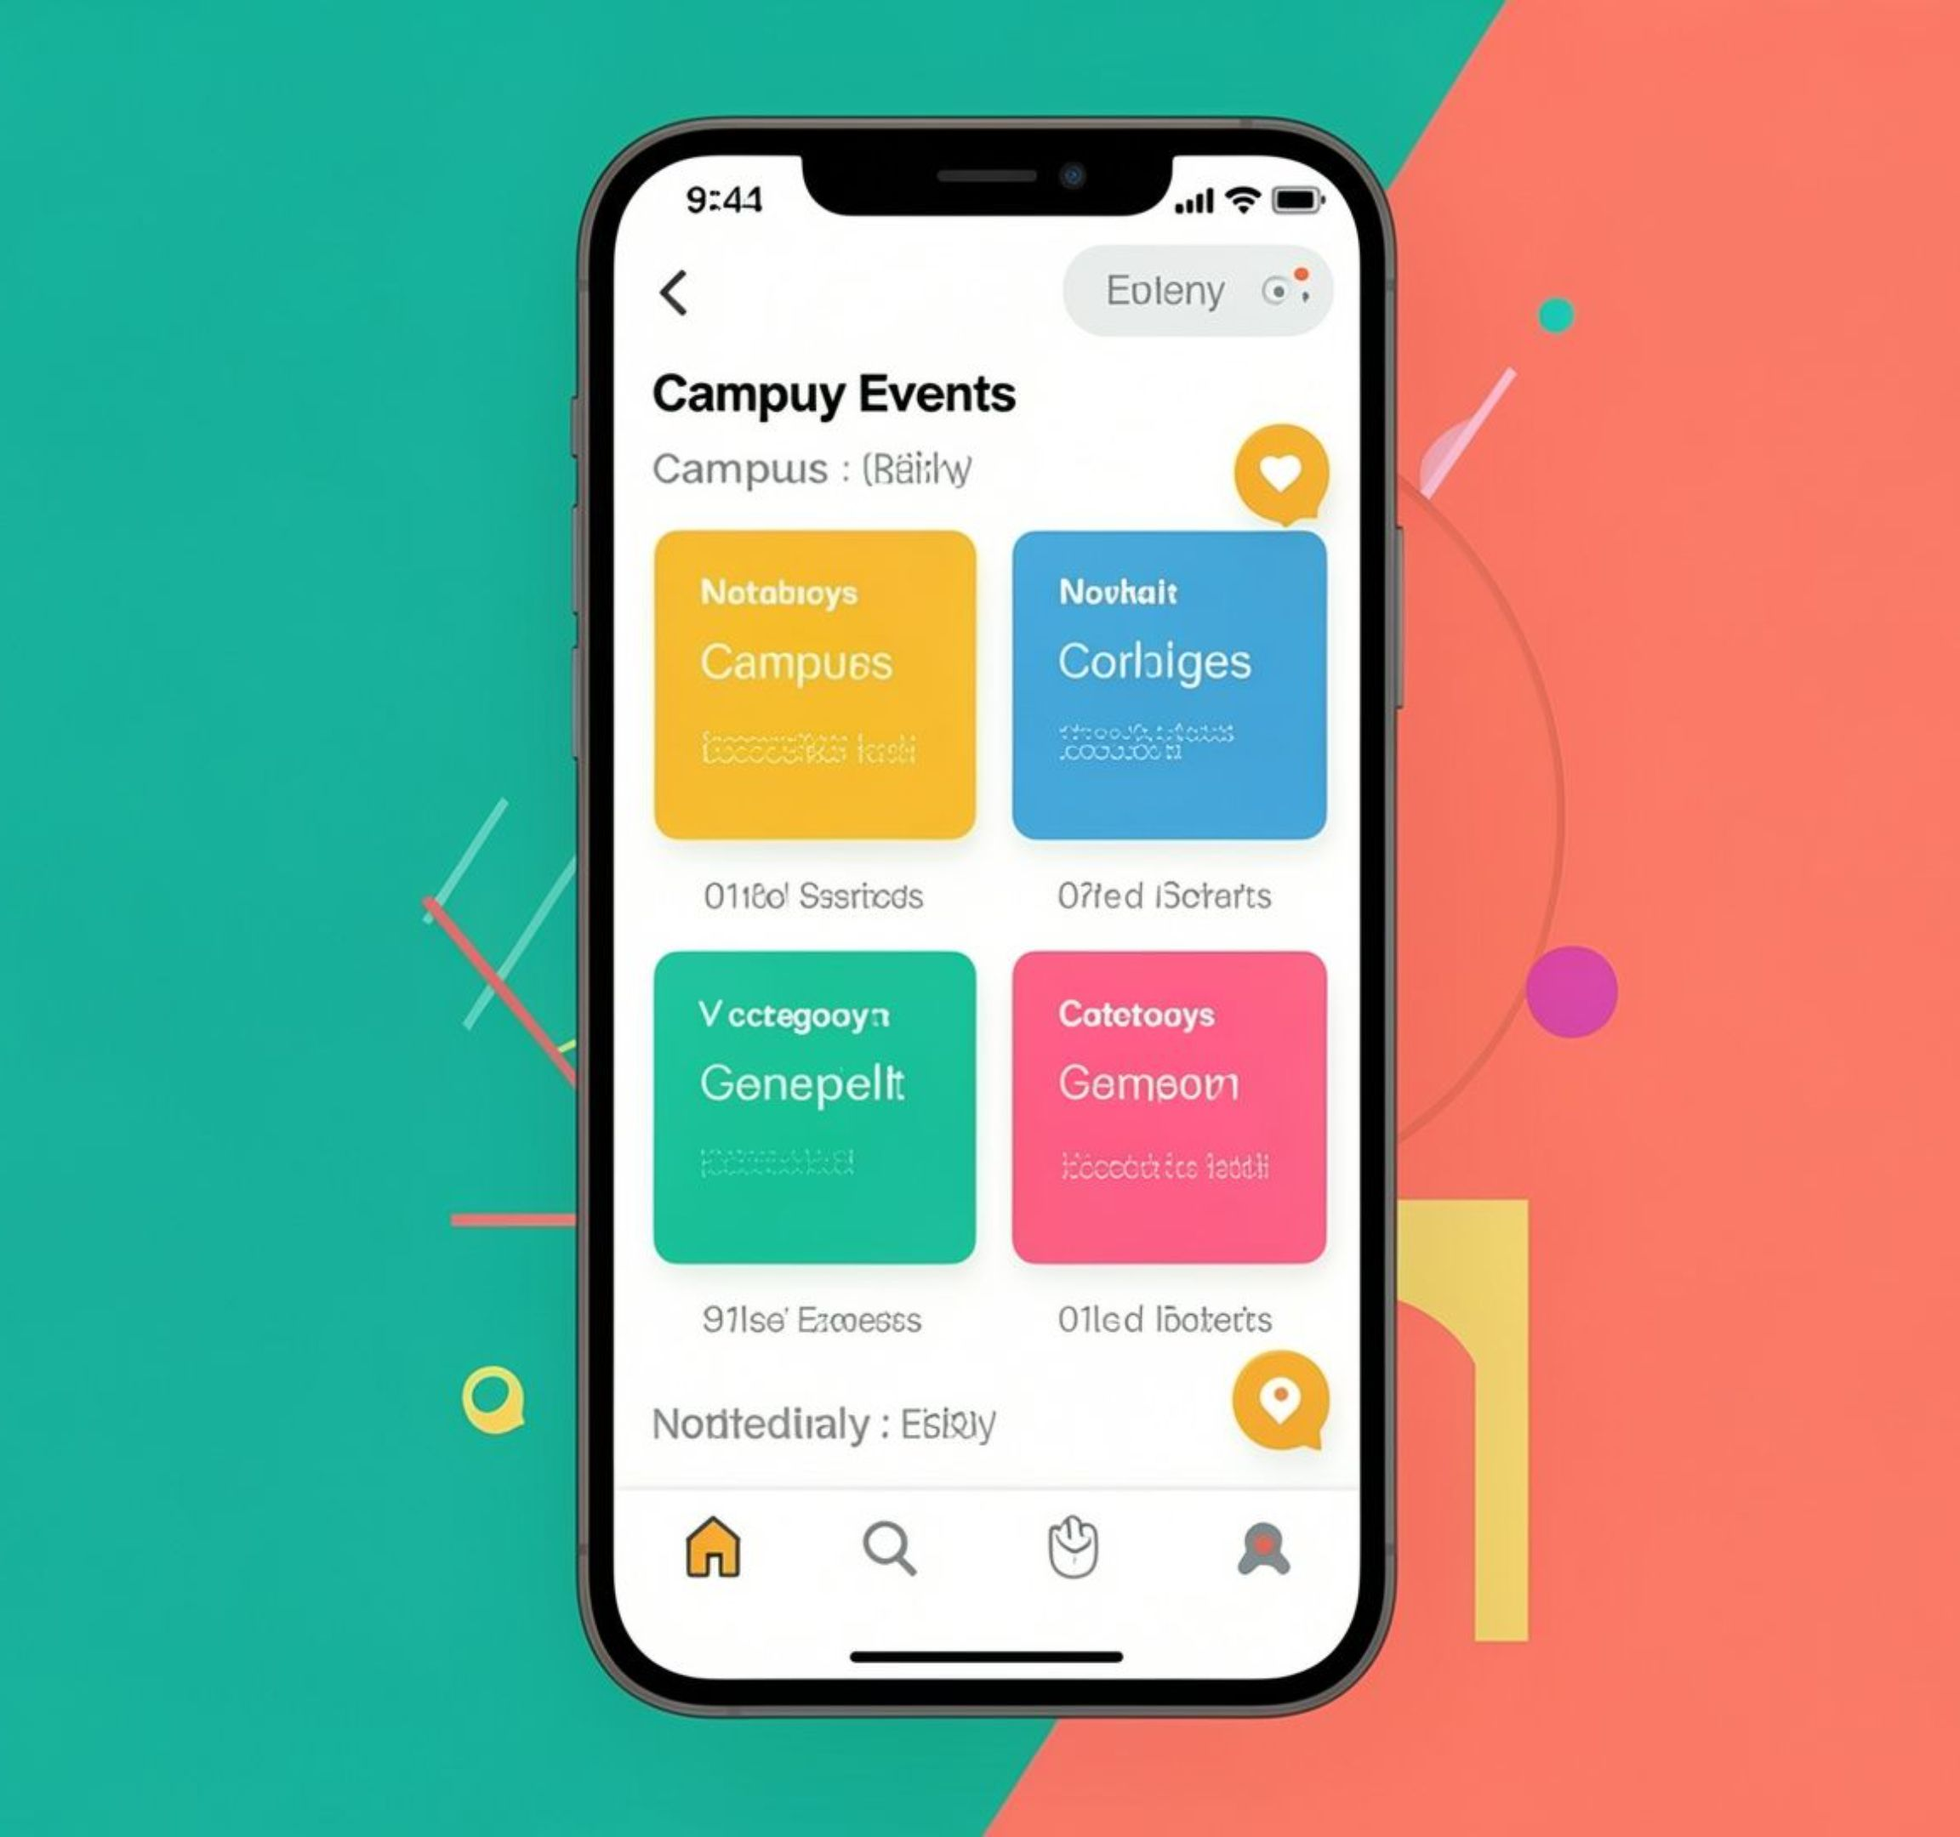
CAMPUSPULSE · THE PROBLEM
CAMPUS LIFE
SHOULD NOT BE
HIDDEN IN A
WHATSAPP GROUP
CampusPulse helps students discover events and helps organizers run them without the chaos.
Notes:
A student hears about an event from one group, then misses the update in another. Meanwhile, the organizer is trying to keep the whole thing moving through scattered messages. CampusPulse brings both sides into one place. First, let’s look at why the current experience breaks down.

Slide 3
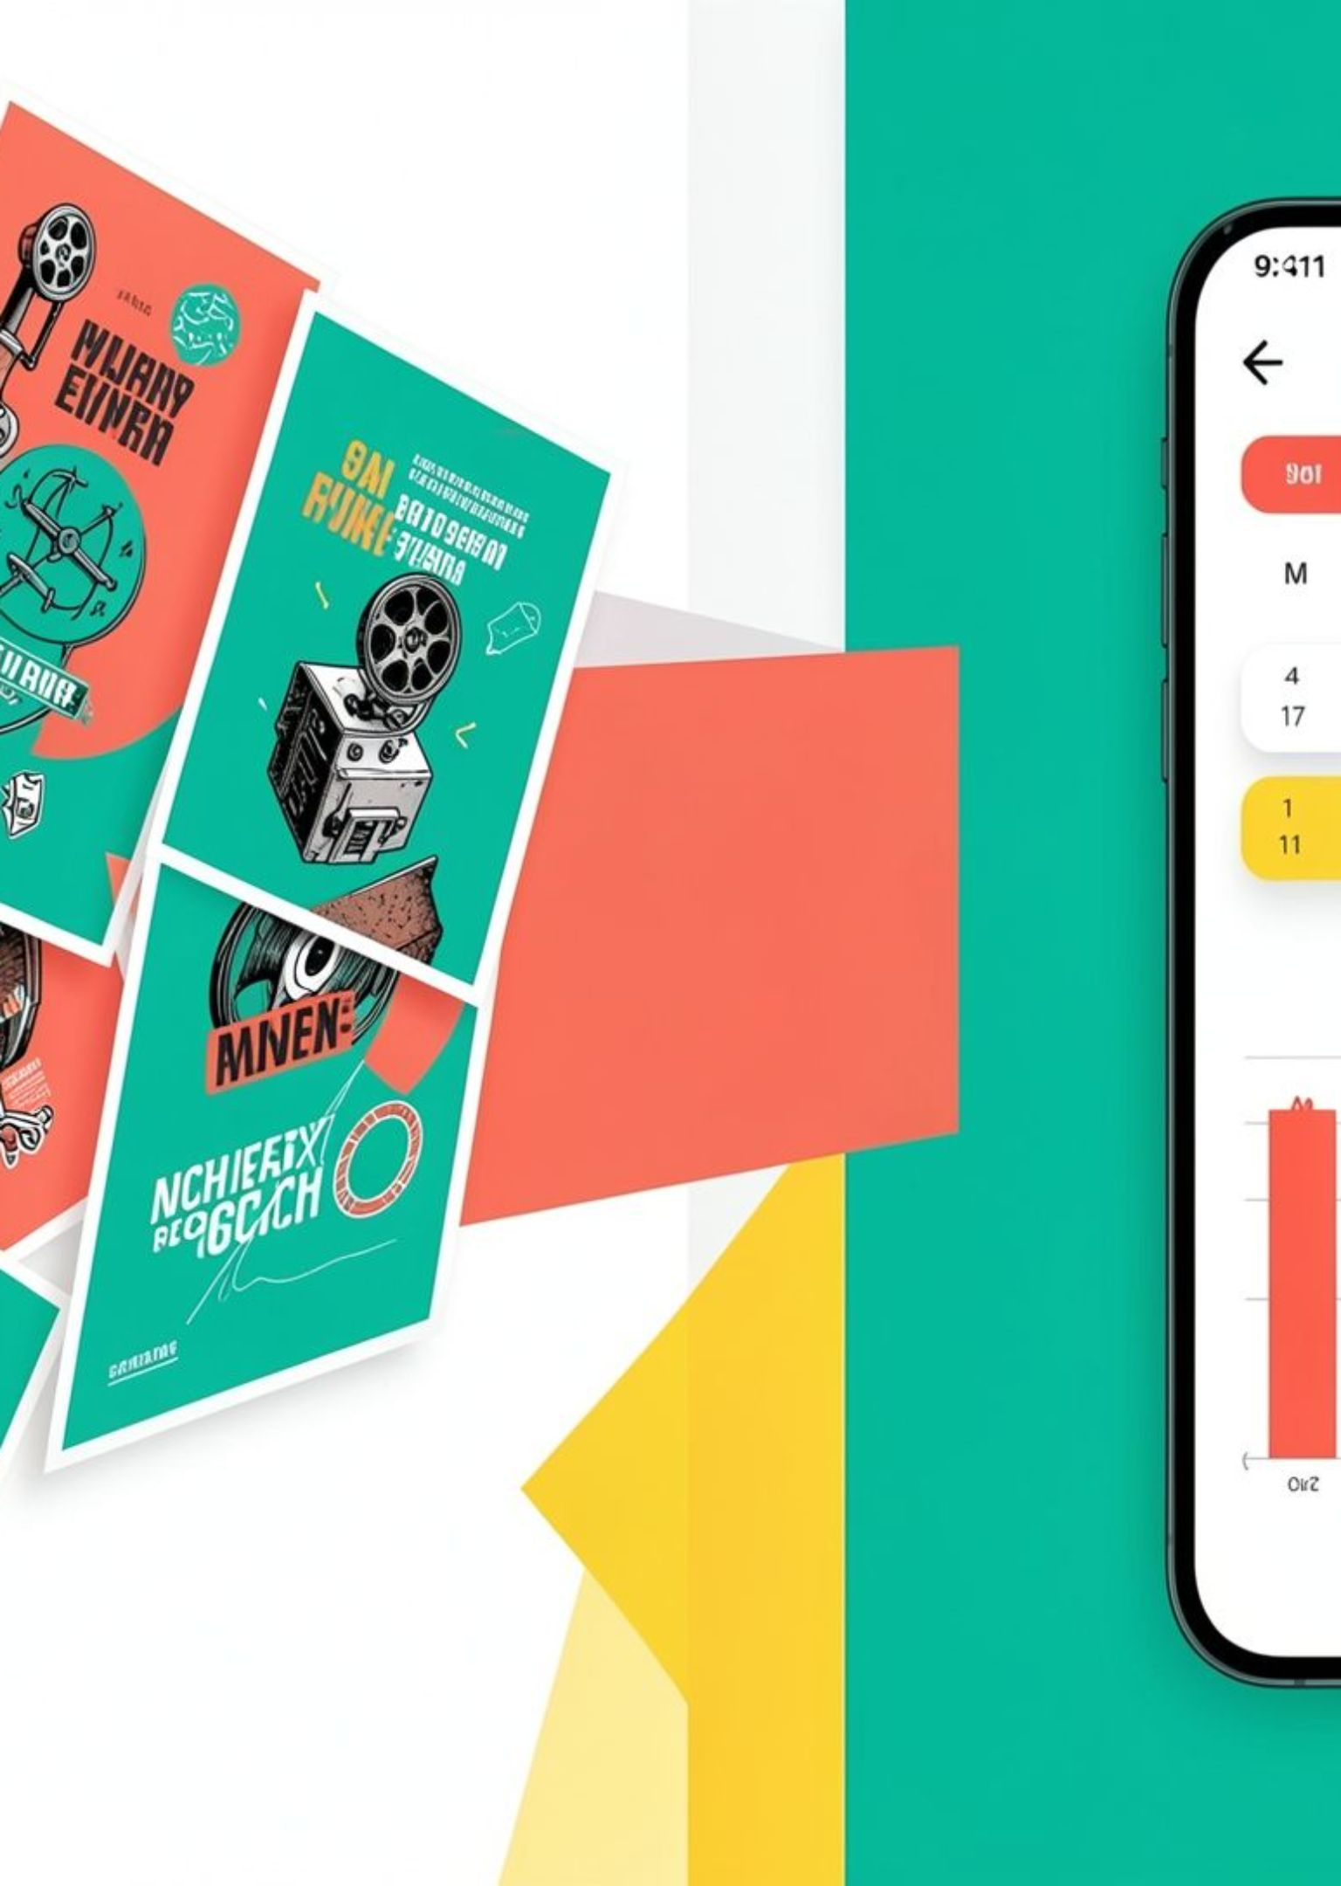
THE CURRENT EXPERIENCE
STUDENTS MISS EVENTS BECAUSE THE INFORMATION IS SCATTERED
01
Updates live across Instagram, WhatsApp, posters, and word of mouth
02
There is no single place to search by category, cost, or interest
03
Organizers still rely on paper forms and manual coordination
04
Attendance data arrives late, if it arrives at all
Notes:
We have all seen this: an event exists, but the update is buried, the poster is somewhere else, and nobody knows which version is current. On the organizer side, paper forms and manual coordination make attendance hard to see. That gives us the opening for one shared platform.

Slide 4


ONE SHARED SYSTEM
ONE PLATFORM CONNECTS THE STUDENT AND ORGANIZER SIDES
Students
Organizers
Students discover, filter, register, and receive a digital ticket.
Organizers publish events, manage capacity, and track check-ins.
One shared system replaces scattered updates and guesswork.
Notes:
The student side gets a clear path from discovery to ticket. The organizer side gets publishing, capacity, and check-ins in the same system. The important part is the connection: one shared system replaces scattered updates and guesswork. Now let’s follow the student journey.

Slide 5



STUDENT JOURNEY · DISCOVERY
FINDING THE RIGHT EVENT TAKES SECONDS
A short path from sign-in to a useful event feed.
Onboard
See the feed
Filter
Simple onboarding captures registration number and department.
A smart feed brings campus events into one view.
Category and cost filters make discovery feel personal.
Notes:
We start with a fresher signing in using a registration number and department. Instead of searching several places, the student sees one smart feed and filters it by category or cost. The goal is simple: finding the right event takes seconds. Next, that choice becomes a ticket.

Slide 6
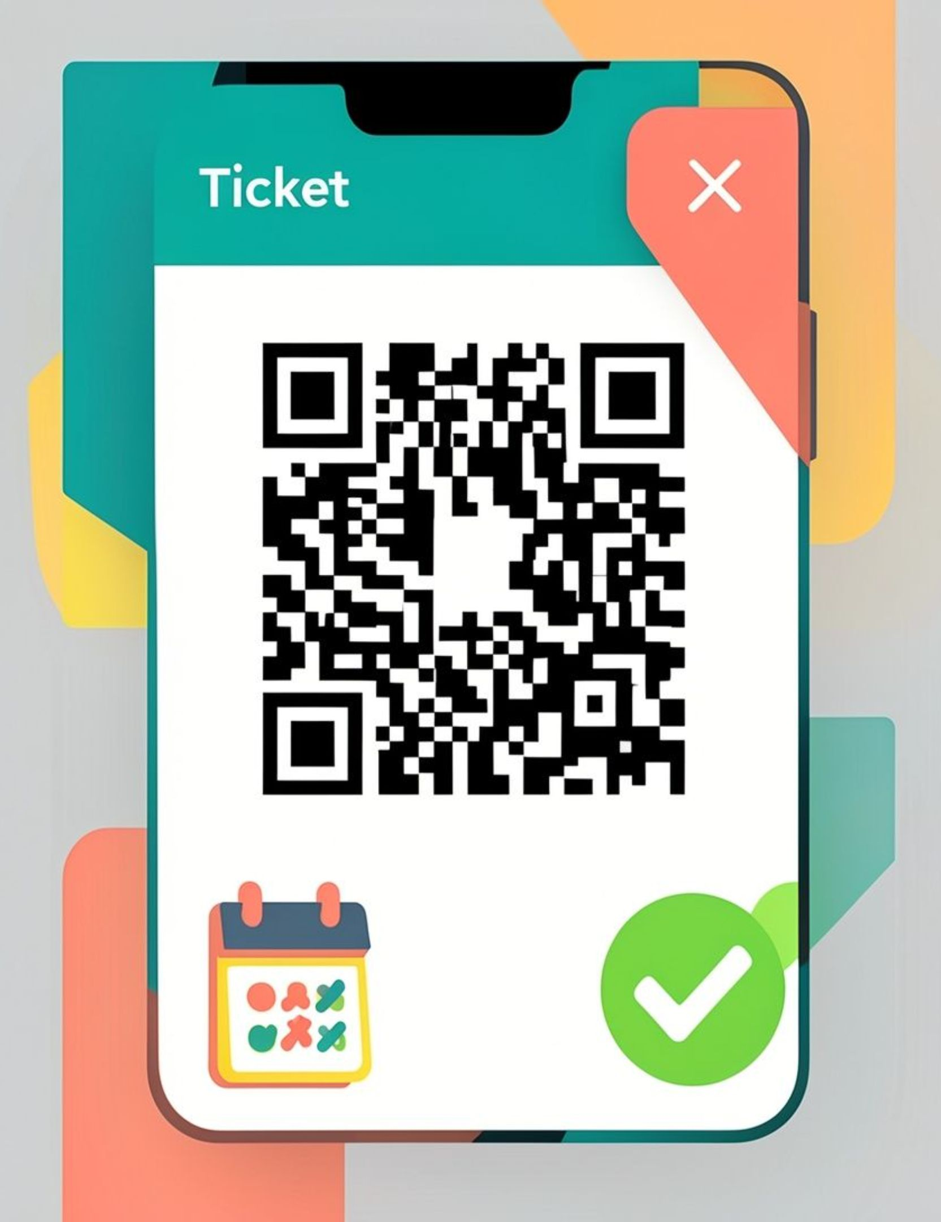
STUDENT JOURNEY · REGISTRATION
REGISTRATION ENDS WITH A TICKET YOU CAN ACTUALLY USE
Free or paid
Free and paid registration flows are simulated in the product.
Dynamic QR ticket
Each registration creates a dynamic QR code ticket.
Calendar-ready
Students can add the event to Google Calendar.
Notes:
The registration flow supports both free and paid events in the product. After registering, the student gets a dynamic QR code ticket and can add the event to Google Calendar. That means the final step is something they can actually use at the door. While students arrive, organizers need a live view.

Slide 7
ORGANIZER JOURNEY · LIVE OPERATIONS
ORGANIZERS CAN SEE THE EVENT AS IT HAPPENS
LIVE DASHBOARD
CHECK-INS
IN VIEW
Three signals
Capacity
Live dashboard shows capacity and check-in status.
QR check-ins replace manual attendance tracking.
Check-ins
QR check-ins replace manual attendance tracking.
Analytics
Real-time analytics turn event management into a clear picture.
Notes:
On the organizer side, the problem is uncertainty: how many people registered, how many arrived, and what is happening right now? The live dashboard shows capacity and check-in status. QR check-ins replace manual attendance tracking, and real-time analytics turn the event into a clear picture. The technology underneath is deliberately simple.

Slide 8
BUILDING CAMPUSPULSE
THE STACK IS SIMPLE, FAST, AND BUILT FOR REAL-TIME UPDATES
React
Tailwind CSS
SIMPLE.
FAST.
REAL-TIME.
React powers the interactive experience.
Tailwind CSS keeps the interface consistent and responsive.
Lucide Icons
Firebase
Lucide Icons keep actions clear and lightweight.
Firebase supports real-time database syncing.
Each tool has one clear job.
Notes:
We kept the stack focused. React powers the interactive experience. Tailwind CSS keeps the interface consistent and responsive. Lucide Icons keep actions clear and lightweight. Firebase supports real-time database syncing, which is what lets the organizer view stay current. With that foundation, we can remove even more admin work.

Slide 9
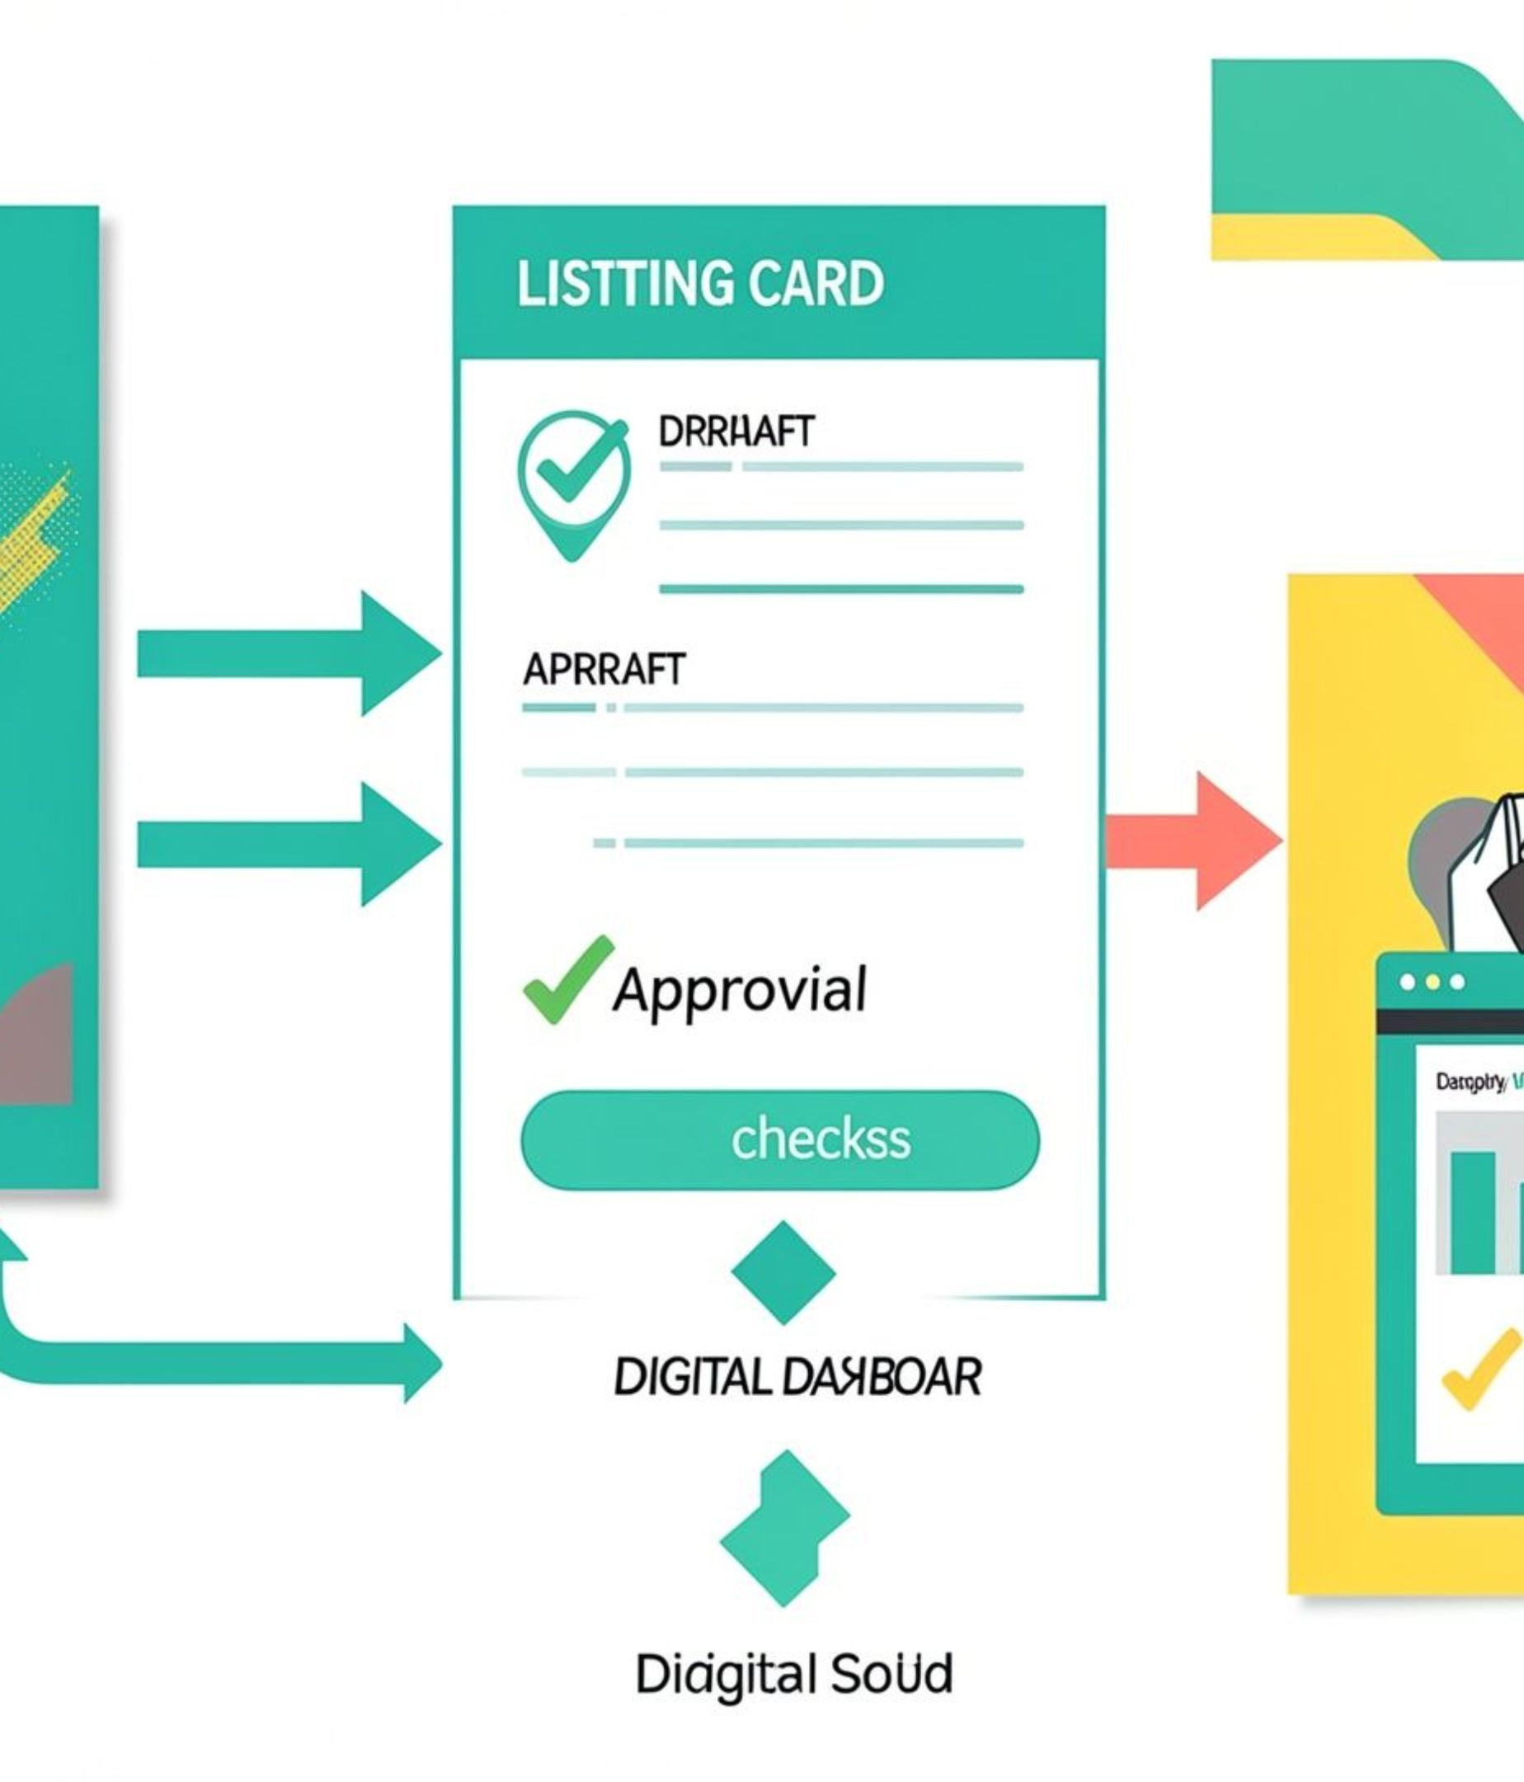
NEXT ITERATION
NEXT, CAMPUSPULSE CAN REMOVE EVEN MORE ADMIN WORK
01
Scan event posters with AI to create draft listings automatically
02
Move approvals from paper to a digital workflow
03
Use campus data to improve timing, reach, and planning
Notes:
Once the core journey works, the next opportunities are about removing admin. An organizer could scan an event poster with AI to create a draft listing, move approvals from paper to a digital workflow, and use campus data to improve timing, reach, and planning. That creates value for both students and colleges.

Slide 10


THE VALUE
BETTER DISCOVERY FOR STUDENTS. BETTER VISIBILITY FOR COLLEGES.
Students
Organizers
Colleges
Students find more opportunities to participate.
Organizers spend less time on forms, conflicts, and counting.
Colleges gain a clearer view of engagement and event demand.
Notes:
The student gets more chances to participate because discovery is easier. Organizers spend less time on forms, conflicts, and counting. Colleges gain a clearer view of engagement and event demand. So the same system makes campus life easier to find and easier to understand. That brings us to the larger experience CampusPulse is designed to create.

Slide 11

CAMPUS
EXPERIENCES
From scattered announcements to one trusted place.
From paper attendance to live visibility.
From “Did anyone see this?” to “Let’s make it happen.”
Local Host: http://localhost:5173/
LAN / Mobile: http://172.16.15.164:5173/
Questions?
Notes:
A student should not miss an event because the information was scattered. An organizer should not have to guess who arrived. CampusPulse moves us from scattered announcements to one trusted place, from paper attendance to live visibility, and from “Did anyone see this?” to “Let’s make it happen.” Questions?

